Slide 1
Employee management system
Name : Karina Khambe
Employee ID : 207013

Slide 2
Agenda
Introduction
Technologies Used
Why Python ?
MySQL Database
Output

Slide 3

What is employee management system ?
A software solution to manage employee data efficiency.
An Employee Management System (EMS) is a tool designed to streamline human resource management by managing employee details, attendance, performance, and payroll.
Our EMS integrates Python with MySQL for data storage and management, providing a reliable and scalable solution.

Slide 4

Technologies used
Python
MySQL
Python Libraries
# MySQL Connector
# OS

Slide 5
WHY PYTHOn ?
Ease of Use : Python is high level, versatile programming language with clear syntax, making development fast and efficient.
Library Support : Python has extensive libraries like numpy, pandas, MySQL.connector for database connectivity and os for system operations, making it ideal for developing an EMS.
Cross – Platform Compatibility : Python applications can be deployed on various platforms with minimal changes.
Community Source : Python has an active and large community, providing resources and libraries to ease development.

Slide 6
Mysql database
Relational Database Management System(RDMS): MySQL uses table to organize and manage data efficiency.
Scalability : MySQL is capable of handelling large volumes of data, making it ideal for employee data storage.
Reliability and Security : MySQL ensures the integrity and security of data, crucial for managing sensitive employee information.
SQL Queries : MySQL supports Structured Query Language (SQL), which allows efficient querying and manipulation of data, making it a robust choice for database management.

Slide 7
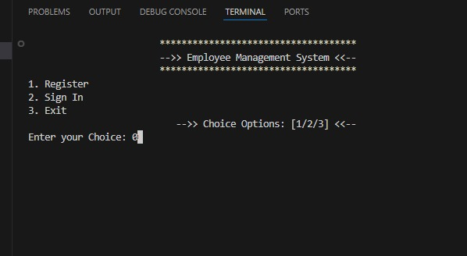

Slide 8
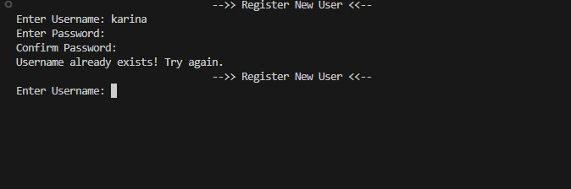
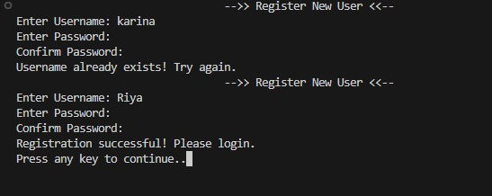

Slide 9
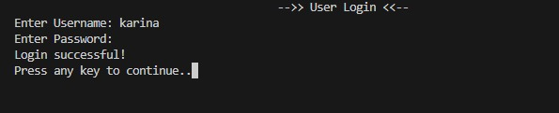
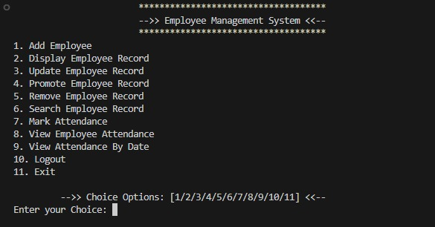

Slide 10
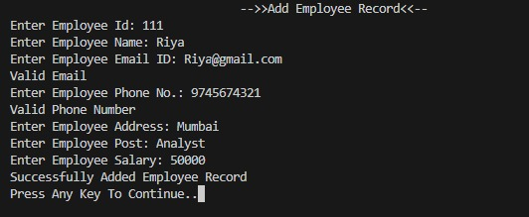
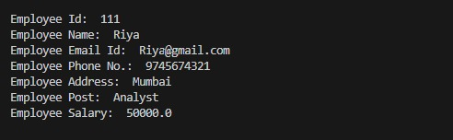

Slide 11
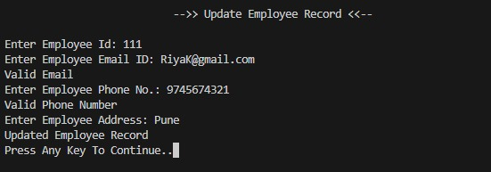
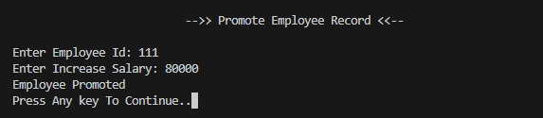

Slide 12
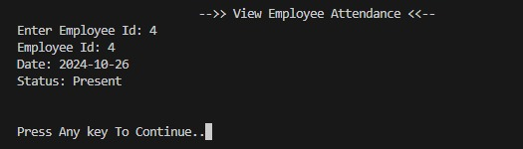
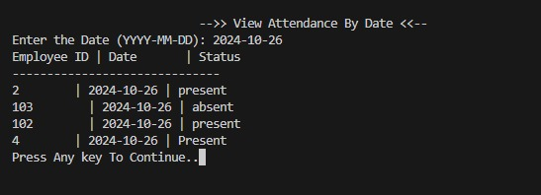

Slide 13
THANK YOU

